Slide 1
Computer Networks
PPT-2: Network Topology
Anand
Department of Computer Science
Keshav Mahavidyalaya

Slide 2
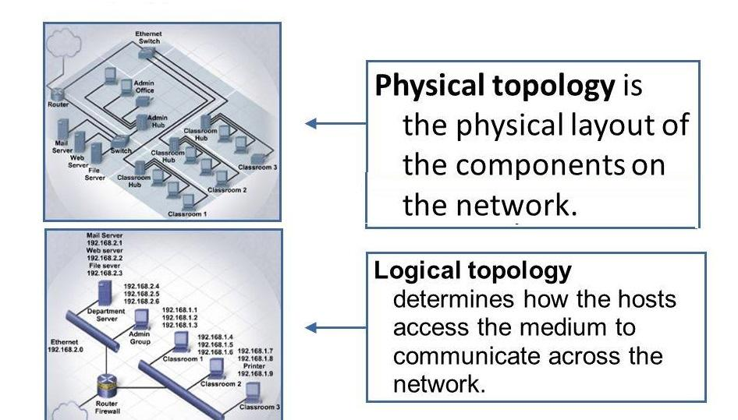
Network Topology
Network topology refers to the physical or logical arrangement of nodes (devices) and the way they are interconnected within a computer network. It defines how data is transmitted between devices and the structure of the network.
Bus
Ring
Star
Mesh
Tree
Hybrid

Slide 3
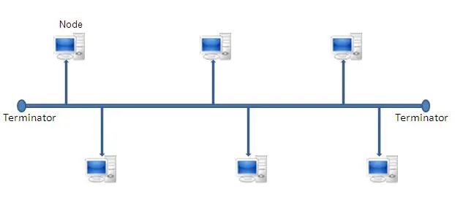
Bus
Advantages of Bus Topology
Simplicity and Cost-Effectiveness
Ease of Installation and Expansion
Suitable for Small Networks
Less Cable Usage
Disadvantages of Bus Topology
Limited Scalability
Single Point of Failure
Performance Issues with Heavy Traffic
Security and Privacy Concerns
Limited Cable Length
Not Suitable for High-Bandwidth Applications
Bus topology is most commonly associated with IEEE 802.3 (Ethernet). Modern Ethernet still follows IEEE 802.3, but the physical topology shifted to star (using switches)

Slide 4
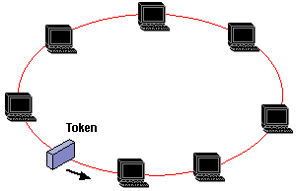
Ring
Advantages
Simplicity
Equal Access to Resources
Data Transmission Efficiency
(unidirectional - avoid collision)
Ease of Expansion
Disadvantages
Single Point of Failure
Difficult Fault Identification
Limited Scalability
Longer transmission time
Slower Data Transfer Rates
If number of nodes increases
Complex Network Management
Less secure
IEEE 802.5 — Token Ring, Developed by: IBM, Collision-free (only the device with the token can transmit)

Slide 5
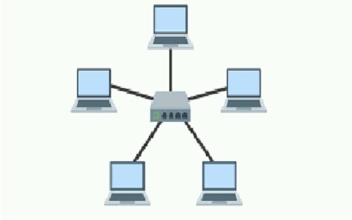
Star
Advantages
Centralized Management
Easy to Install and Expand
Reliable Performance
Isolation of Devices
Scalability
Better Performance in Heavy Traffic
Security
Disadvantages
Single Point of Failure
Dependency on Central Hub
Cost of Installation
Addition central device
Limited Scalability
Scalability Limits with Hub Capacity
IEEE 802.3 — (Modern Ethernet)

Slide 6
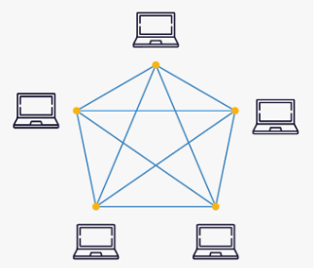
Mesh
Advantages
Redundancy and Reliability
Fault Tolerance
Supports Point-to-Point Communication
Privacy and Security
Disadvantages
Cost
Complexity of Installation and Maintenance
Limited Scalability
High Wiring Requirements

Slide 7
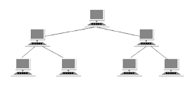
Tree
Advantages
Easily scalable and expandable.
Hierarchical structure for better organization.
Fault isolation within branches.
Efficient use of resources with a central hub.
Centralized control for easier management.
Easy to expand without disrupting the network.
Disadvantages
Dependent on the central root node.
Can become complex to manage as it grows.
Requires more cables, leading to higher costs.
Performance may degrade with increased load.
Expensive and time-consuming maintenance.
Limited by the bandwidth of the backbone.

Slide 8
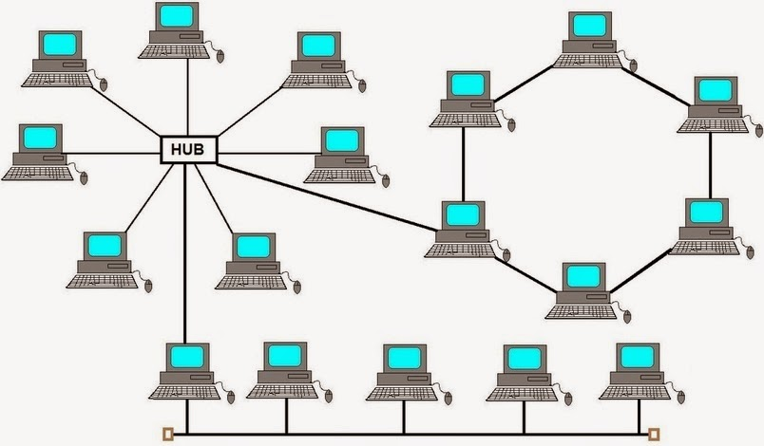
Hybrid
The purpose of implementing a hybrid topology is to leverage the strengths of multiple topologies while mitigating their individual weaknesses. By combining different topologies, a hybrid network can be customized to meet specific requirements and provide a more flexible and robust infrastructure.
Improved Reliability
Scalability
Cost Efficiency
Optimized Performance
Enhanced Security

Slide 9
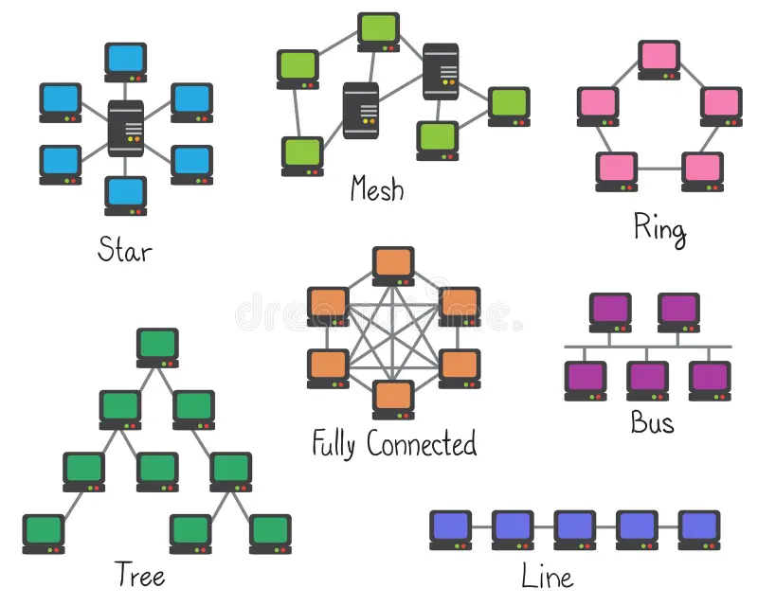

Slide 10
Problems on Topology
Topology | Nodes (N) | No of Cables (NC) | No. of Ports per device (NOP) | Total No. of Ports (TNOP)
Bus | N | N + 1 | 1 | N
Ring | N | N | 2 | 2xN
Star | N | N | 1 | N
Mesh | N | N(N-1)/2 | N-1 | N(N-1)

Slide 11

Next Lecture

Slide 12
Computer Networks
PPT-2b: Network Topology 2b
Anand
Department of Computer Science
Keshav Mahavidyalaya

Slide 13
IEEE
IEEE (pronounced "Eye-triple-E")
IEEE stands for the Institute of Electrical and Electronics Engineers, the world's largest technical professional organization, dedicated to advancing technology and innovation. IEEE 802.3 is the IEEE standard that defines Ethernet—the most widely used technology for wired local area networks (LANs). IEEE 802.3 specifies:
Physical layer (Layer 1)
Data Link layer – MAC sublayer (Layer 2)

Slide 14
The 802.3 Frame Structure

Slide 16
IEEE

